Slide 1

Machine Learning in Imaging and Vision
Dr. R. Balasubramanian
Professor
Department of Computer Science and Engineering
Indian Institute of Technology Roorkee
Roorkee 247 667
balarfcs@iitr.ac.in

Slide 2
Organization of the Lecture
Introduction
Brain-Computer Interface
PHOG+HMM
Wavelet+HMM
Human Action Recognition
Blob Extraction
Feature Extraction
LDA Tree based Classifier
SVM Tree based Classifier
Facial emotion classification
Directed Acyclic Graph SVM
Other Applications
Deep Learning

Slide 3
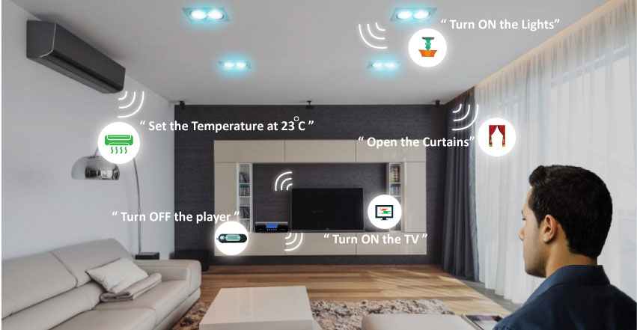
Smart House

Slide 4
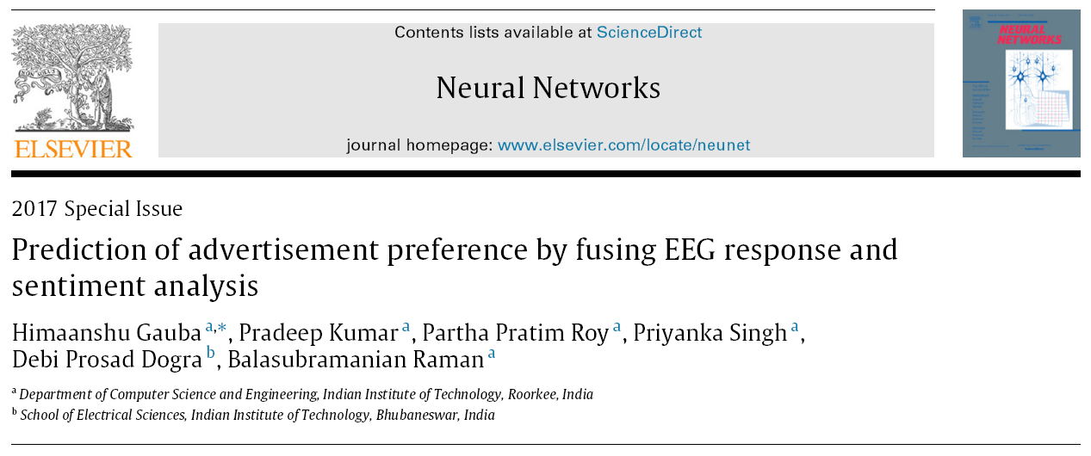

Slide 5
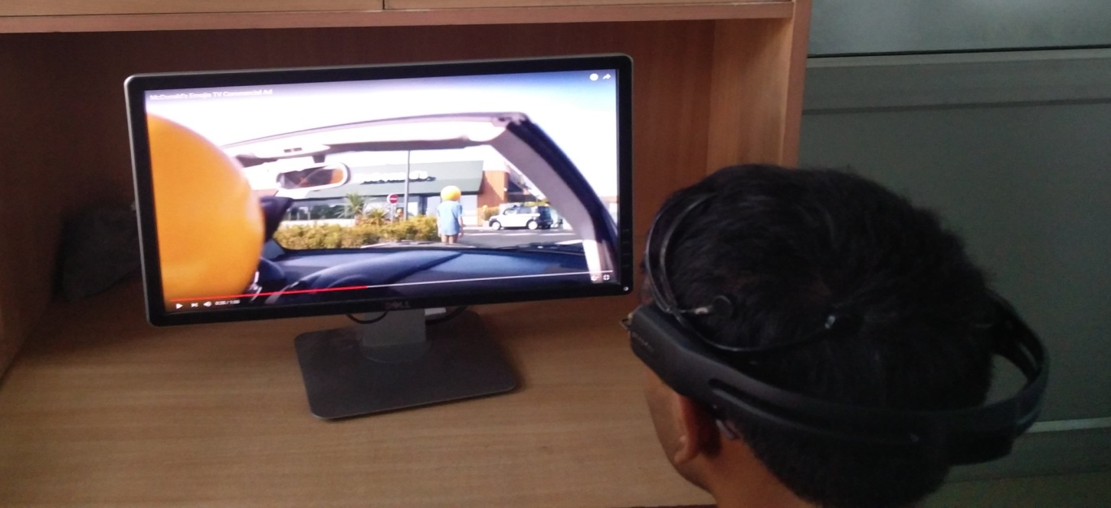
Multimodal Framework
A fusion of two different modalities has been proposed:
a. Electroencephalogram (EEG): a brain wave sensing technology that measures and records the electrical activity of the brain.
b. Sentiment Analysis: it represents the opinion or attitude of a writer towards a product. For example videos, products etc.

Slide 6
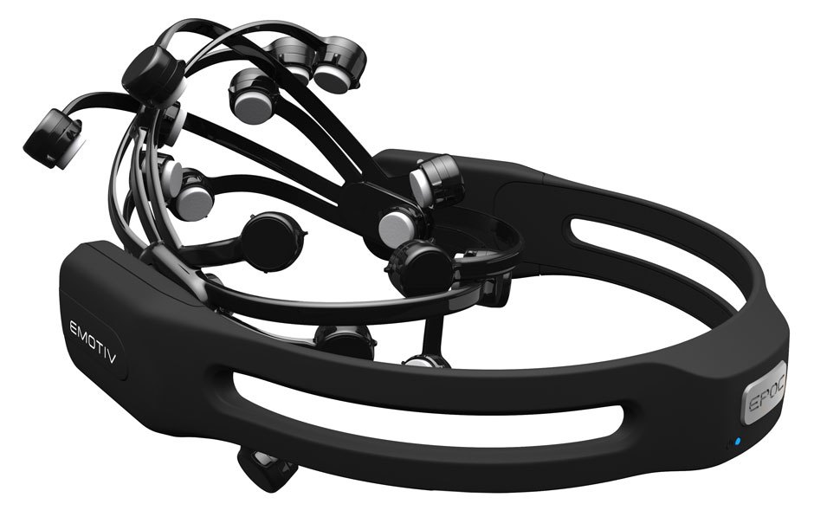
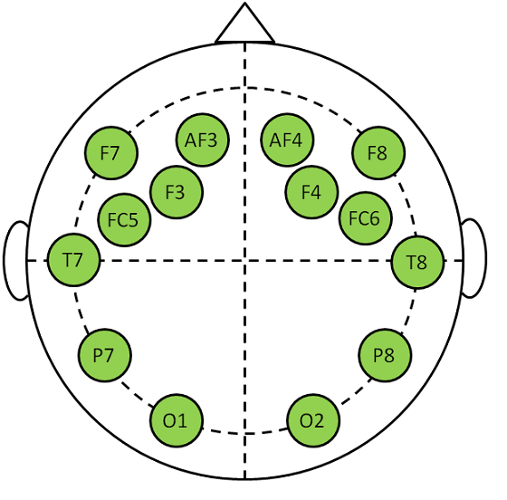
EEG headset
The EEG headset consists of 14 channels that are used to record brain activities while watching videos.
The placement of electrodes on the scalp of the user are as per 10-20 International system.

Slide 7
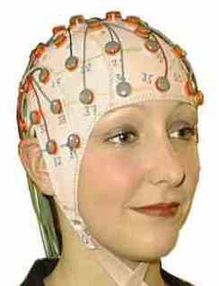
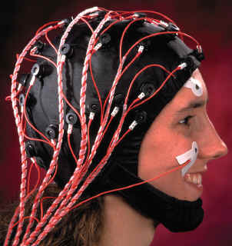
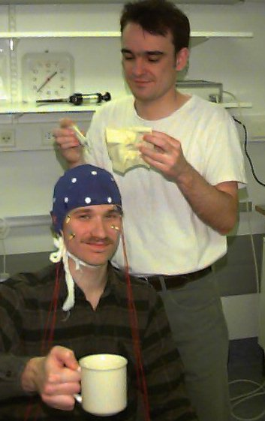
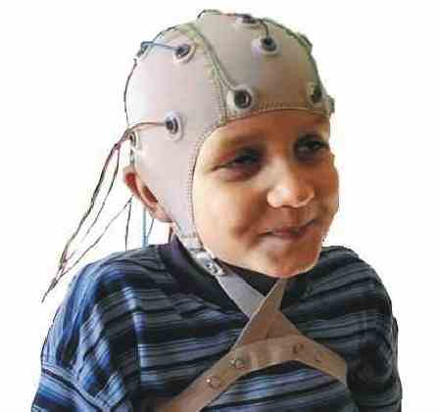
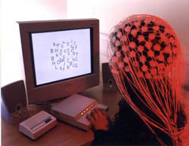
EEG Devices

Slide 8
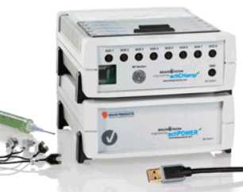
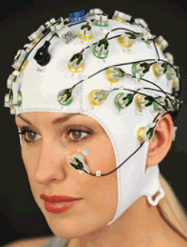
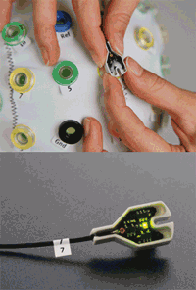

Proposal of EEG Device
ACTICHAMP
actiCHamp
actiCAP

Slide 9
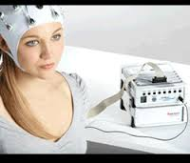
Proposal of EEG Device: Properties
actiCHamp
versatile active channel 24-bit amplifier from 32 channles up to 160 channels
impedance displayed by a colour LED on the electrode cap itself
recording of high quality EEG signals, even with a high impedance
can also be used with Dry Electrodes for BCI
offers 8 integrated AUX inputs (for sensors)
offers an extremely high sampling rate up to 100 KHz (ABR)
able to receive trigger inputs (8-bit, TTL)
Robust electrode wires

Slide 10
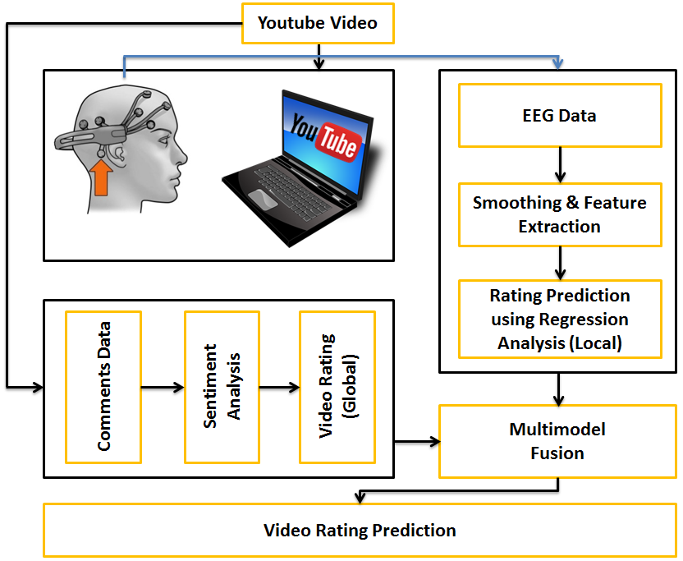
Architecture of the framework

Slide 11
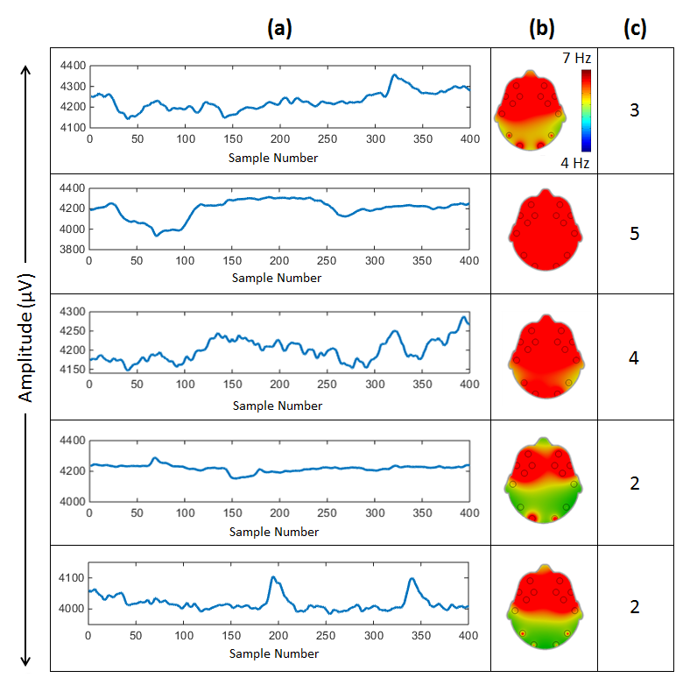
Users feedback and brain-activity maps
Users feedback to different videos can be analyzed using their EEG signals and brain activity maps.

Slide 12
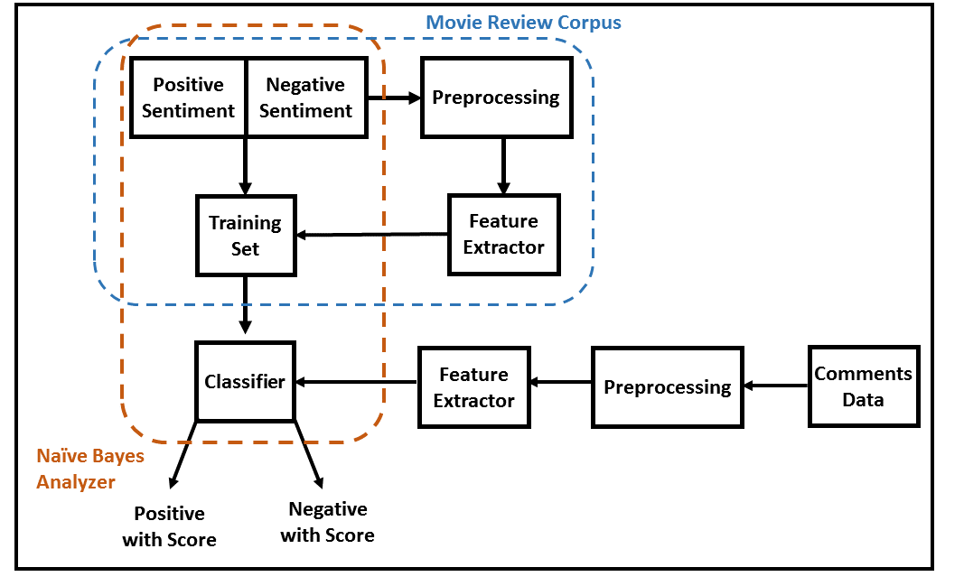
Sentiment Analysis
Sentiment Analysis of the users comments on Youtube have been performed to extract the global rating (Polarity Score) of the videos.

Slide 13
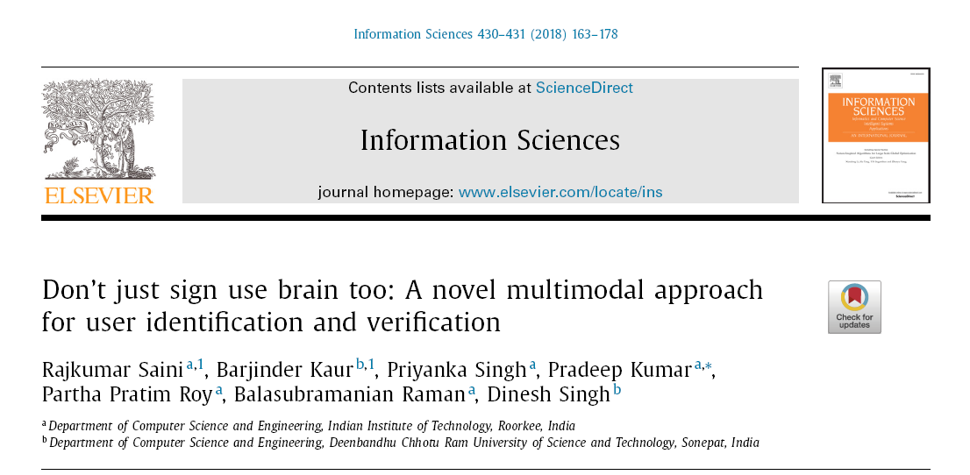

Slide 14
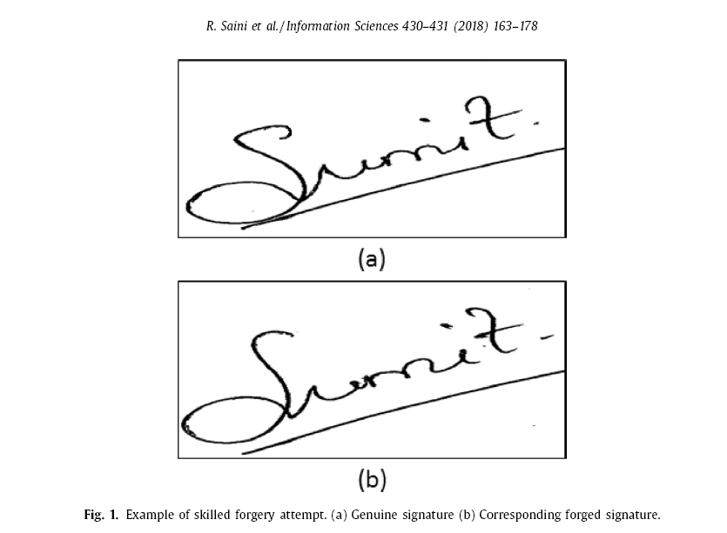

Slide 15
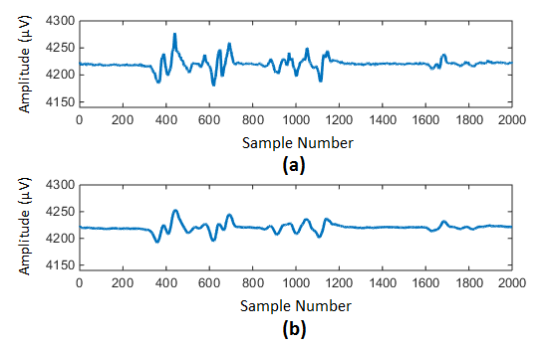
Signal smoothing
Moving-average filter and Independent-Component-Analysis (ICA) have been applied to remove the effect of artifacts due to eye blinking and body movements.

Slide 16
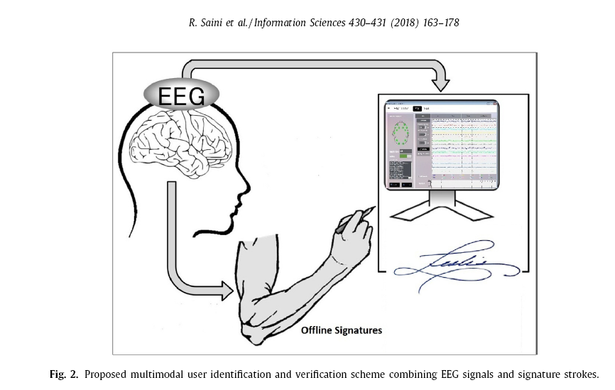

Slide 17
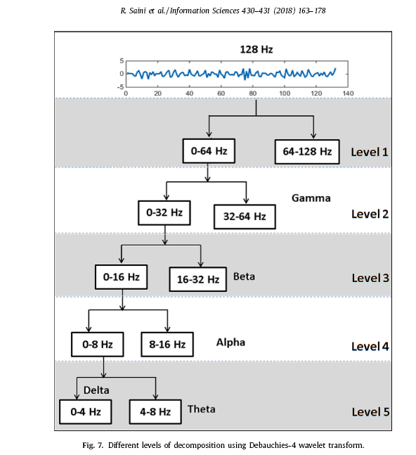

Slide 18
Approach
PHOG+HMM→Signature
DWT+HMM →Brain Signal

Slide 19
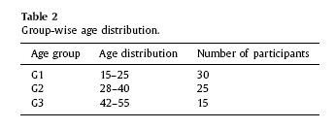
We have collected a dataset consisting of 70 subjects (40 males and 30 females) with age ranging from 15 to 55 belonging to Indian Institute of Technology Roorkee, India.

Slide 20
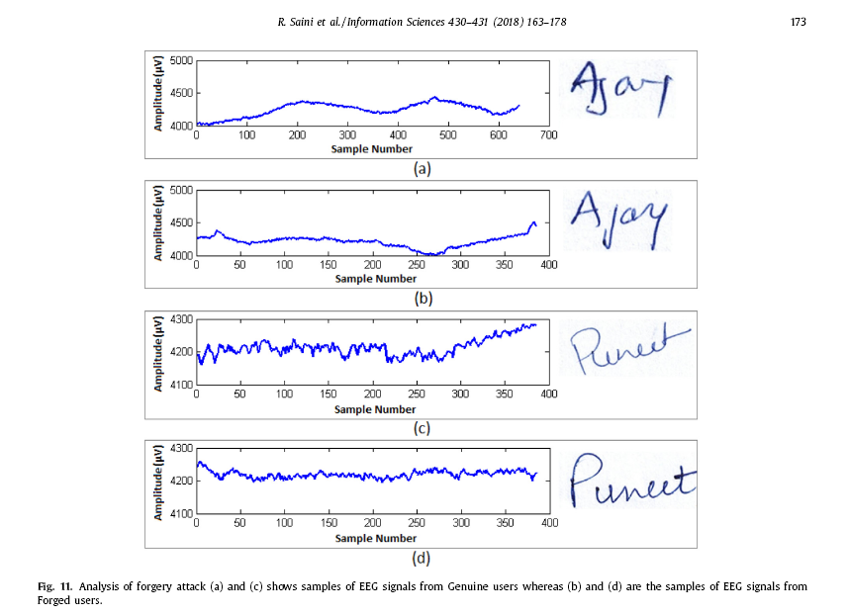

Slide 21
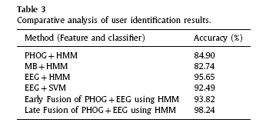
Accuracy

Slide 22
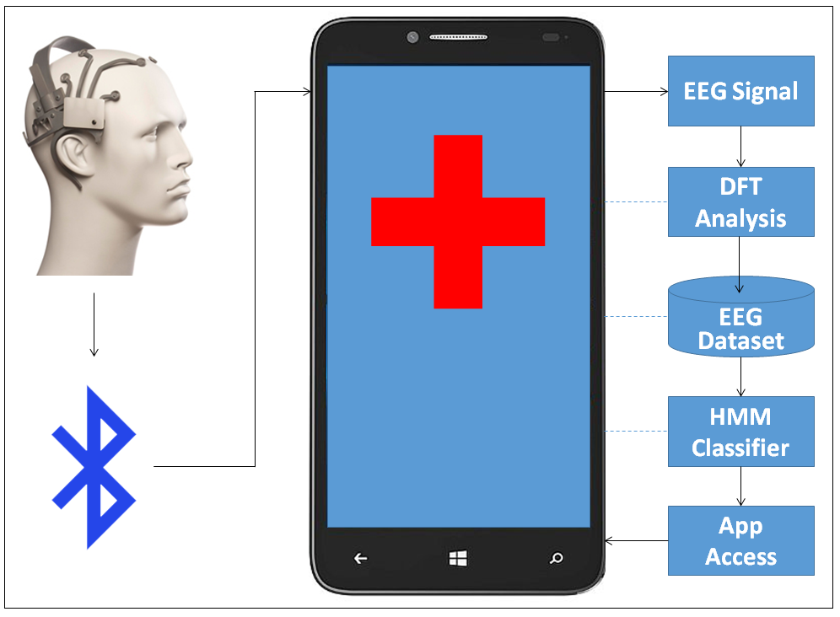
Neurophone: Assistive Framework
Pradeep Kumar, Rajkumar Saini, Pawan Sahu, Partha Pratim Roy, Debi Prosad Dogra, Balasubramaninan Raman, ‘Neuro-phone: An assistive framework to operate Smartphone using EEG signals’, IEEE Tensymp 2017.

Slide 23

Basic Applications
Pradeep Kumar, Rajkumar Saini, Pawan Sahu, Partha Pratim Roy, Debi Prosad Dogra, Balasubramaninan Raman, ‘Neuro-phone: An assistive framework to operate Smartphone using EEG signals’, IEEE Tensymp 2017.

Slide 24
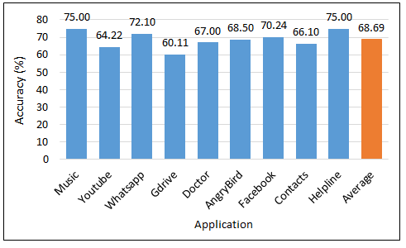
Results for Neurophone
Pradeep Kumar, Rajkumar Saini, Pawan Sahu, Partha Pratim Roy, Debi Prosad Dogra, Balasubramaninan Raman, ‘Neuro-phone: An assistive framework to operate Smartphone using EEG signals’, IEEE Tensymp 2017.

Slide 25
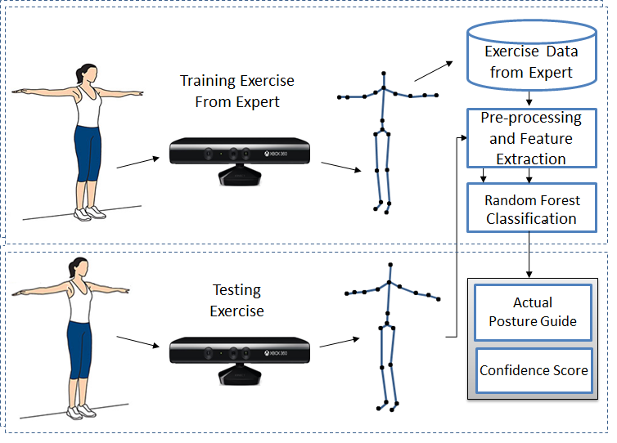
Virtual Trainer
Pradeep Kumar, Rajkumar Saini, Mahendra Yadava, Partha Pratim Roy, Debi Prosad Dogra, Balasubramanian Raman, ‘Neuro-phone: An assistive framework to operate Smartphone using EEG signals’, IEEE Tensymp 2017.

Slide 26
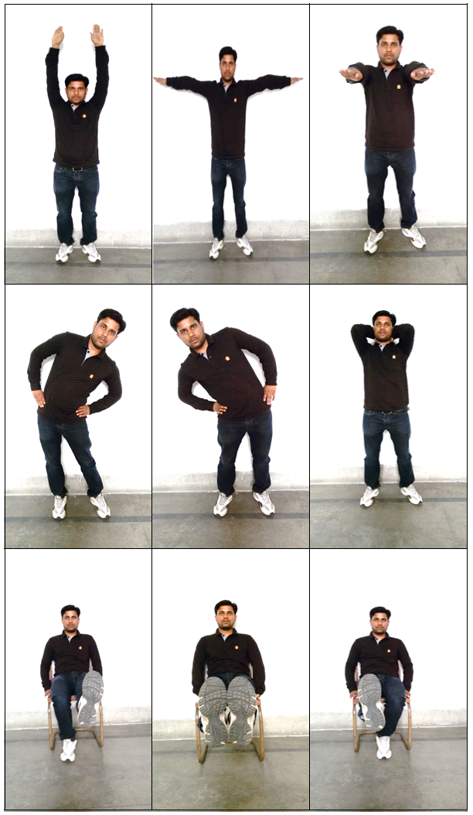
Basic Exercise
Pradeep Kumar, Rajkumar Saini, Mahendra Yadava, Partha Pratim Roy, Debi Prosad Dogra, Balasubramanian Raman, ‘Neuro-phone: An assistive framework to operate Smartphone using EEG signals’, IEEE Tensymp 2017.

Slide 27
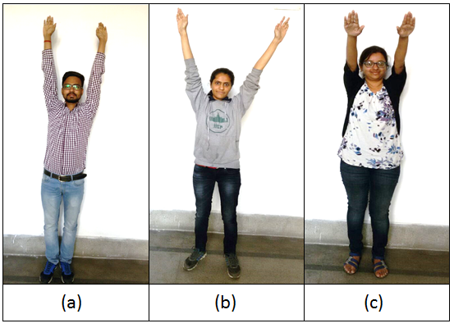
User Examples
Pradeep Kumar, Rajkumar Saini, Mahendra Yadava, Partha Pratim Roy, Debi Prosad Dogra, Balasubramanian Raman, ‘Neuro-phone: An assistive framework to operate Smartphone using EEG signals’, IEEE Tensymp 2017.

Slide 28
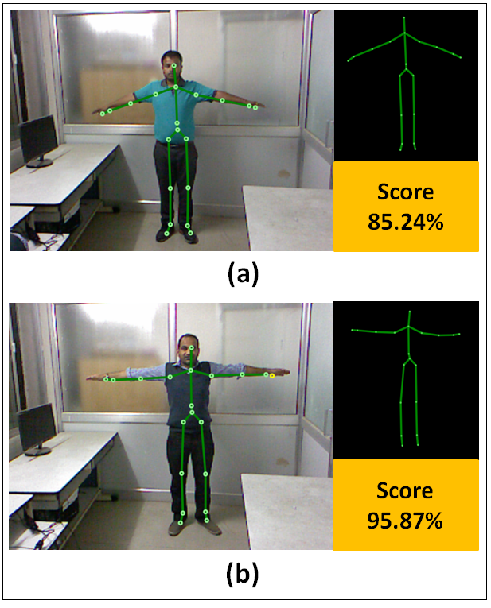
Results
Pradeep Kumar, Rajkumar Saini, Mahendra Yadava, Partha Pratim Roy, Debi Prosad Dogra, Balasubramanian Raman, ‘Neuro-phone: An assistive framework to operate Smartphone using EEG signals’, IEEE Tensymp 2017.

Slide 29
Human Action Recognition
Generally, the correct action recognition depends on two factors:
Extraction of feature vectors from video sequences, and
Implementation of a good classifier.
In this context,
We have adopted a skeleton based feature extraction algorithm corresponding to a given human activity.
A new classifier, called LDA Tree and a novel classifier, called SVM Tree have been proposed to classify these features into their corresponding classes.
The proposed classifier has been evaluated on a publicly available human action database, namely ViHASi database and some real video sequences.

Slide 30
Introduction cont :
Steps involved in proposed action recognition framework:
Feature extraction:
Blob extraction in case of PTZ/moving camera.
Skeleton computation
Feature extraction
Implementation of LDA Tree and SVM tree classifiers.

Slide 31
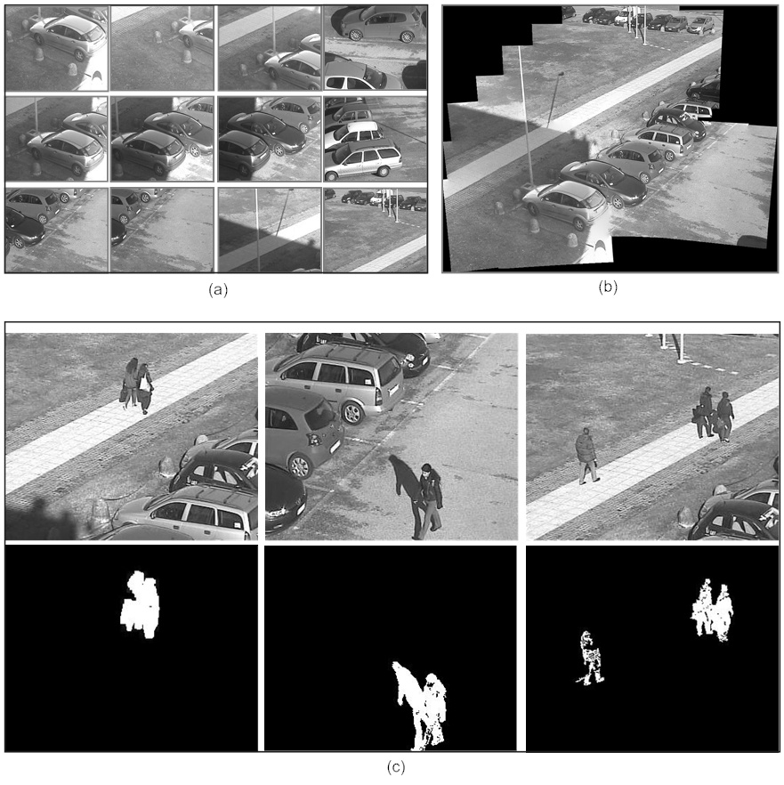
Blob extraction in case of PTZ camera

Slide 32
Change detection
Build background Mosaic image
Base image
Register the another image on base image
Object detection using background Mosaic image
Register frame having foreground object on mosaic image
Frame background comparison
Skeleton of the detected object
Silhouette of the detected object
Skeleton of the silhouette

Slide 33
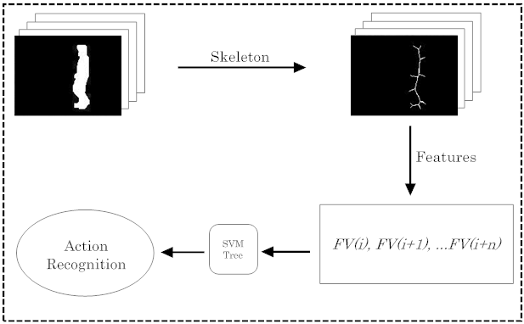
Overview of the Proposed Technique:

Slide 34
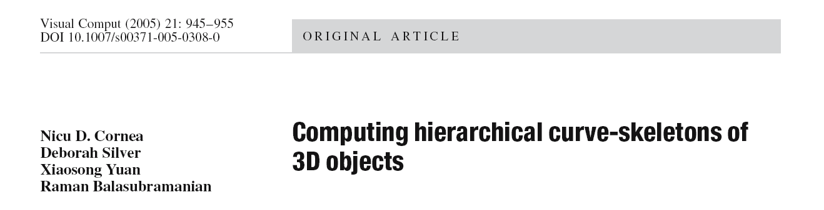


Slide 35
Skeletonization
Medial axis in 2D/Medial Surface in 3D
b1
*
Ski
b2

Slide 36
Skeletonization

Slide 37
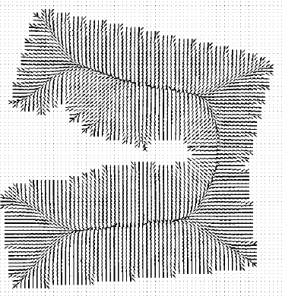
2D Cases

Slide 38
Objects and their Skeletons

Slide 40
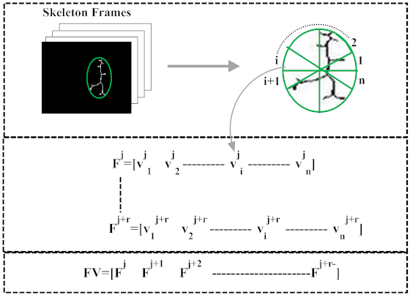
Computation of attributes

Slide 41
Steps Involved in feature extraction
Obtain the skeleton from a silhouette of the detected human blob.
Divide the bounding box of the skeleton in n equal sectors along its centre.
Count the pixels of the skeleton falling in each sector and arrange them in a linear vector.
Normalize this vector by dividing the total number of pixels belonging to the skeleton.
The feature vector corresponding to any activity is obtained by taking r consecutive frames .

Slide 42
(1) Linear Discriminant Analysis (LDA)
The objective of LDA is to seek the direction not only maximizing the between-class scatter of the projected samples, but also minimizing the within-class scatter.
where S_{B} is defined as
m is the k-dimensional sample mean for whole set
m_{i} is the sample mean for i^{th} class

Slide 43
Within-class scatter matrix S_{W} is defined as
where S_{i} is the scatter matrix corresponding to i^{th} class.
LDA suffers with two problems :
The degenerated scatter matrices caused by the ‘small sample size’
The classification performance is often degraded by the fact that their separability criteria is not directly related to their classification accuracy in the output space.

Slide 44
LDA Tree based classifier
Modeling
all the patterns p_{i} of training set S₀ at a root node v₀
project these patterns into a new space
Finding projection matrix M_{root}
Portioning
Each node is split into two or more sub nodes
Euclidean distances
pattern p_{i} is assigned to the class corresponding to the minimum distance
Stopping
All patterns are belonging to the same class only
All patterns are belonging to the same class only up to a uniformity factor
At most one class has more than m cases

Slide 45
LDA Tree based classifier
Algorithm : Classification phase of LDA Tree
Set v = v₀
While v leaf node do
Input f to v
if v=LDA node then
Set v = vi corresponding to arg min_{i} d_{i}
end if
end while
Assign f to c_{i} corresponding to v

Slide 46
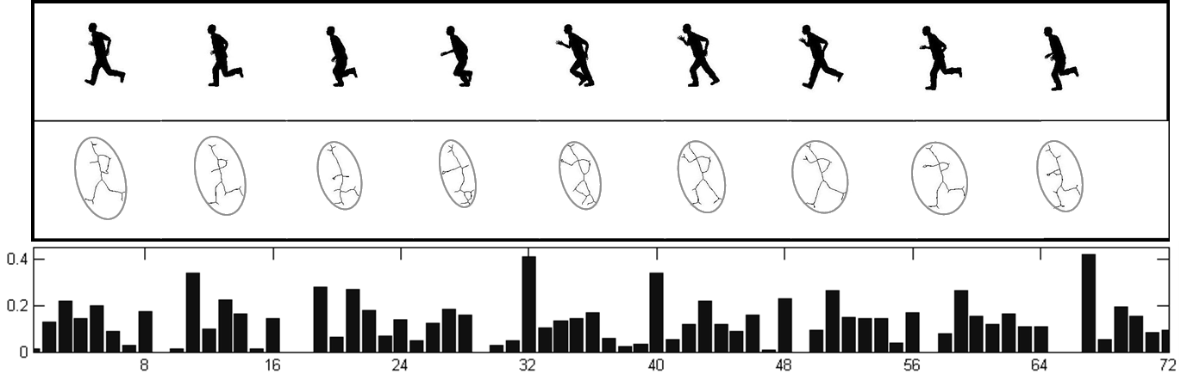
Results and Discussions
The proposed action recognition is tested on benchmark database and PTZ camera based surveillances system. ViHASi¹⁹ is used to check the performance of LDA Tree based classifier for recognizing the correct action. The overall bounding ellipse of skeleton has been divided into eight equal sectors. We have taken nine consecutive frames for representing an activity. The feature vector corresponding to an activity contains 72 attributes. Silhouettes corresponding to consecutive frames of Run action from ViHASi database :

Slide 47
Experiments with ViHASi database
Action classes in ViHASi database
C | Action Name | C | Action Name
1 | Hang On Bar | 11 | KnockoutSpin
2 | Jump Get On Bar | 12 | Knockout
3 | Jump Over Object | 13 | Granade
4 | Jump From Object | 14 | Collapse
5 | Run Pull Object | 15 | Stand Look
6 | Run Push Object | 16 | Punch
7 | Run Turn 90 Left | 17 | JumpKick
8 | Run Turn 90 Right | 18 | Walk
9 | Hero Smash | 19 | WalkTurnBack
10 | Hero Door Slam | 20 | Run

Slide 48
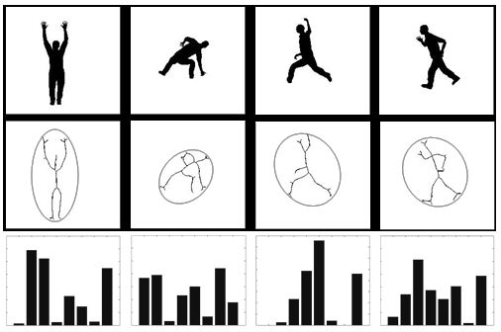
Experimental Results Dataset description & Feature Extractions for ViHASi
In ViHASi database, we have used 6 actors (A1, A2, A3, A4, A5, A9) and 12 camera views (V1, V3, V4, V6, V8, V9, V11, V13, V14, V16, V18, V19). At each iteration we have tested 12 samples corresponding to one single action class performed by one single actor and captured from 12 camera views.

Slide 49
Comparison Results
A comparison study has been conducted between the proposed classification method and a single-shot LDA based classification on ViHASi dataset.
Action (C) | 1 | 2 | 3 | 4 | 5 | 6 | 7 | 8 | 9 | 10 | 11 | 12 | 13 | 14 | 15 | 16 | 17 | 18 | 19 | 20
Proposed | 0 | 0 | 1 | 1 | 1 | 0 | 0 | 1 | 0 | 2 | 0 | 0 | 1 | 1 | 0 | 0 | 0 | 1 | 0 | 0
Single-shot LDA | 1 | 1 | 2 | 1 | 2 | 1 | 0 | 1 | 1 | 5 | 1 | 2 | 0 | 2 | 3 | 0 | 0 | 2 | 0 | 1
Misclassified Patterns in ViHASi dataset

Slide 50
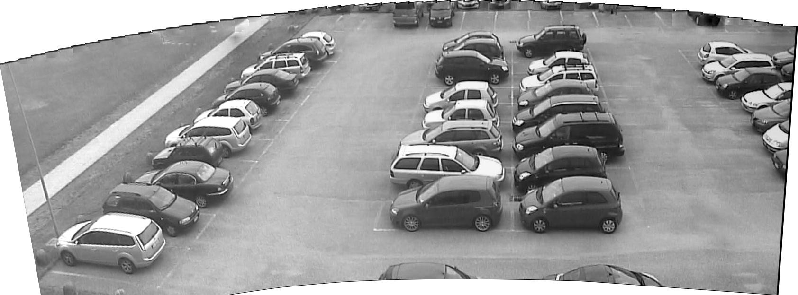
Background Mosaic of our test site

Slide 51
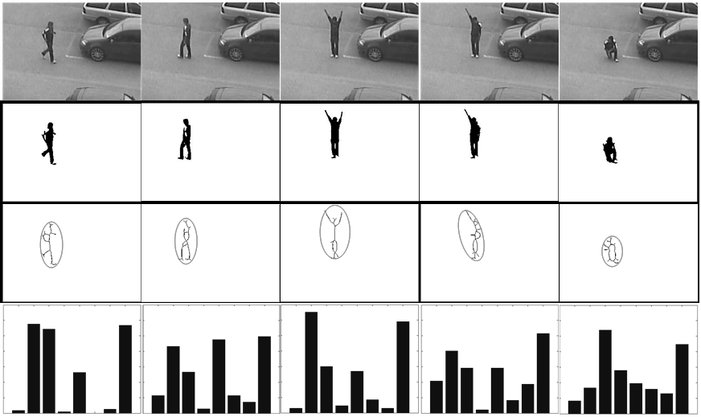
Experimental Results on our dataset:
12 sequences are acquired for each person repeating an action twice in different position and zoom settings. 36 test-sequences are acquired followed by the feature extraction.The leave-one-out scheme is adopted for evaluation, by randomly taking one person as the testing data, and the other eight persons for training.

Slide 52
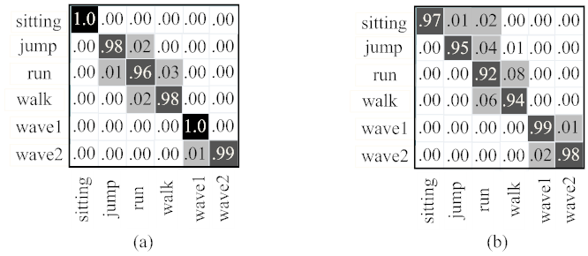
Confusion Matrices for our PTZ camera based Dataset
(a) proposed LDA Tree based classier (b) single-shot LDA based classier.
The achieved classification accuracy by the proposed method is 98.5%,
while it is found 95.8% in case of single-shot LDA based classifier.

Slide 53
(2) SVM Tree based Classifier
Support Vector Machine (SVM) is well suited for predictive data analysis.
Various methods exist for multiclass classification.
One-against-all
One-against-One
Directed Acyclic Graph SVM (DAGSVM)
We employ the Lagrangian SVM algorithm for solving the dual of the standard quadratic program of SVM. The average convergent efficiency of SVM Tree is

Slide 54
SVM Tree based Classifier: kernels
We have used two different kernel functions, namely the polynomial and the radial basis function (RBF).
The polynomial kernel can be given as
where p is the degree of the polynomial.
The RBF kernel is given as
For soft margin classifier, we include the penalty parameter C to penalize the data points those cross the boundary.

Slide 55
SVM Tree based Classifier: Classification
Once the tree is built by learning the patterns, it can be used to classify the testing set of patterns.
In the classification phase, a pattern starts traversing the tree from the root node.
It moves through the tree in a top-to-down way, adopting the path suggested by the classification given by each node.
When a leaf node is reached, the pattern is classified corresponding to the label of this node.
In this way, all patterns from a testing set can be classified into their corresponding classes.

Slide 56
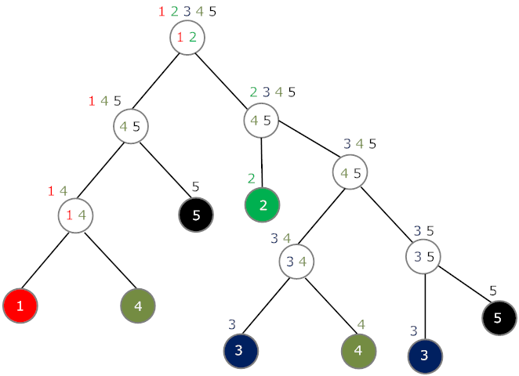
Implementation of SVM Tree

Slide 57
Experimental Results Dataset description & Feature Extractions for ViHASi
In ViHASi database, we have used all eleven actors (A1, A2, A3, A4, A5, A9, A10, A11) and two camera views (CamN1 & CamN3).

Slide 58
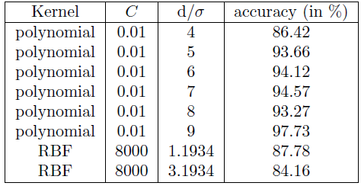
Comparison Results
Accuracy assessment for the classification of ViHASi database

Slide 59
Confusion Matrix for the classification
The achieved classification accuracy by the proposed method is 97.73%.

Slide 60
Sign Language Recognition

Slide 61
Sign Language Recognition

Slide 62
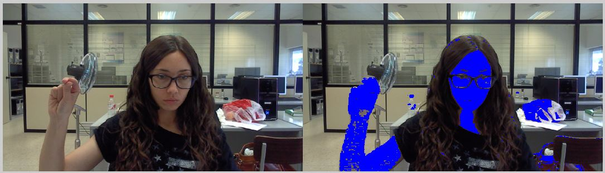
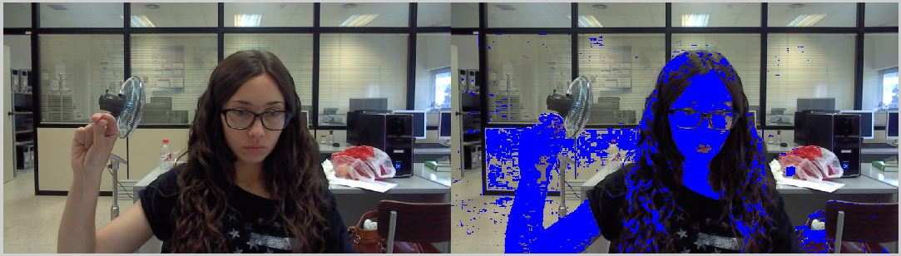
Color model
We have used explicit threshold values for each color channel to separate skin colored pixels.
Figure3.8 Skin detection using RGB threshold
Figure3.9 Skin detection using HSV threshold
Notes:
RGB :combination of chromatic and luminance in this model makes it sensitive to noise than other models.
Hue represents the color, saturation is the light present in the color or color purity and value describes the color brightness.

Slide 63
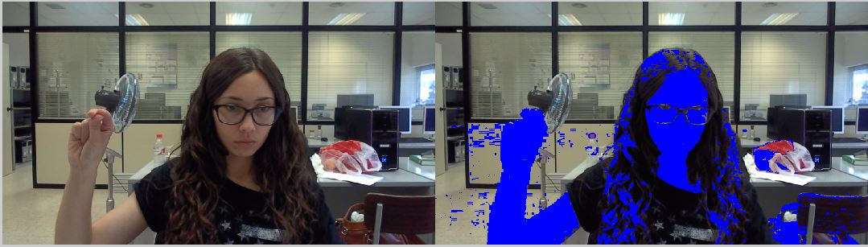
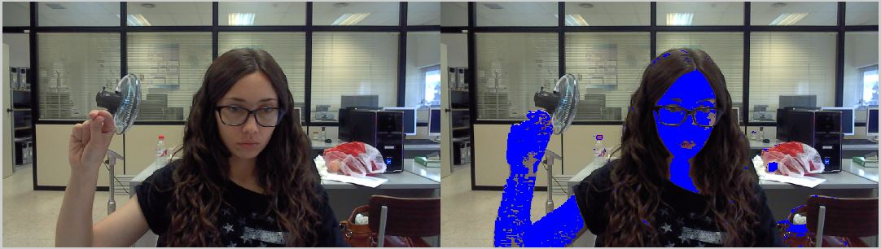
Color model
Figure3.10 Skin detection using YCbCr threshold
Figure3.11 Skin detection using combination of models
Notes:
YCbCr model has separated chrominance from the luminance makes this model best suitable for the skin color detection.

Slide 64
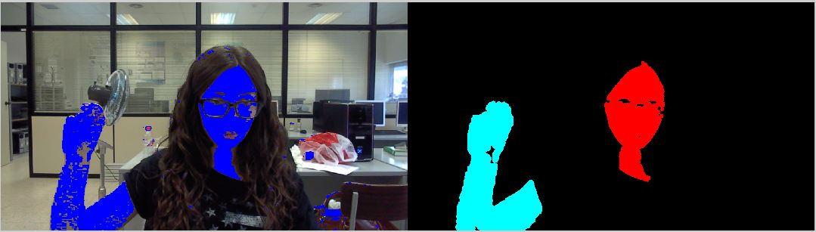
3.2.2.3 Morphological operations
Figure 3.13 Output after applying Morphological operations

Slide 65
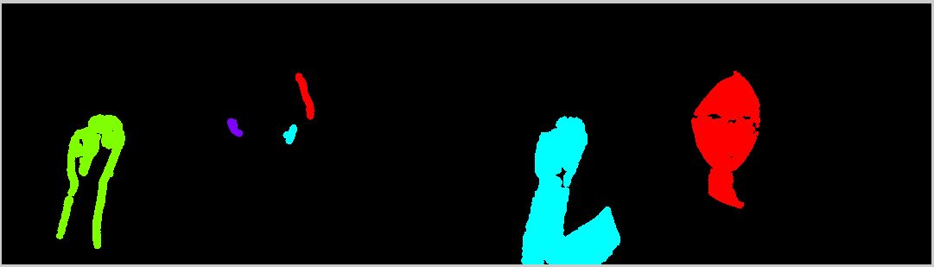
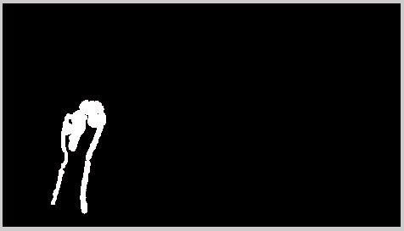
3.2.3 Bitwise AND
Figure 3.14 Outputs from Background subtraction and Skin detection respectively
Figure 3.15 Final extracted hand image

Slide 66


Results of SVM
Figure 5.7 Confusion matrix for SURF and SVM
Accuracy 68.83%,
Figure 5.8 Confusion matrix for Wavelet and SVM
Accuracy 74%

Slide 67


Results of LDA
Figure 5.10 Confusion matrix for LDA and SURF
Accuracy 75.6%
Figure 5.11 Confusion matrix for LDA and Wavelet
Accuracy 98.83%

Slide 68
Dense Motion Analysis of German Finger Spellings
Multimedia Tools and Applications (Springer)
https://doi.org/10.1007/s11042-018-6533-0, 2018

Slide 69

Dense Motion Analysis of German Finger Spellings
Fig. : Background subtraction corresponding to the sequence of individual frames.

Slide 70

Cont....
The top row contains the frames corresponding to a gesture. The middle row depicts extracted key-points, and the last row shows corresponding dense trajectories.

Slide 71

Proposed approach
Fig : Training and testing phases of the proposed approach.

Slide 72

1.5 RWTH German finger- spelling database
Fig : The German finger spelling database containing 35 dynamic gesture classes.

Slide 73

Comparison
Table : Standard accuracy measures and comparisons of proposed approach.

Slide 74
Visible watermarking based on importance and just noticeable distortion of image regions
Himanshu Agarwal, Debashis Sen,
Balasubramanian Raman and Mohan Kankanhalli
Multimedis Tools Applications (Springer)
July 2016, Volume 75, Issue 13, pp. 7605–7629

Slide 75





Motivation: Occlusion Problem

Slide 76
Problem Definition
Visually embed a watermark in a given image (monochrome or color) at N positions such that important/significant portions of the image are not occluded, where, N is greater than or equal to one.

Slide 77



Saliency and Just Noticeable Distortion Map
A sample image
Saliency map
Just noticeable distortion map

Slide 78

Block Diagram of the Proposed Watermark Embedding Strategy for sub-image

Slide 79

Block Diagram of the Proposed Watermark Embedding Algorithm to Embed a Watermark at N non-overlapping positions

Slide 80




Experiments: Sample result to demonstrate the accuracy of the proposed mathematical model with respect to proposed watermarking algorithm. N=5
Watermark 64X64 pixels.
Original image. 177X284 pixels.
Watermarked image

Slide 81



Experiments: Sample watermarks
100X100 pixels
120X120 pixels
120X120 pixels

Slide 82




Experiments: Comparison of three methods for finding watermarking positions
(a) Original image. 511X681 pixels. (b) Eye fixation density. (c) Saliency (d) Variance
(a)
(b)
(c)
(d)

Slide 83




Experiments: Comparison of three methods for finding watermarking positions
(a) Original image. 511X681 pixels. (b) Eye fixation density. (c) Saliency (d) Variance
(a)
(b)
(c)
(d)

Slide 84
Experiments: Visibility of watermark changes with respect to significance details in images.

Slide 85


Experiments: More sample results. Watermarking positions are found using visual saliency.
(a)
(b)
Original image. (b), (c) watermarked images. Observations:
watermarking position depends on size of watermarks.
visibility of watermarks change with respect to significance level of watermarking positions.
(c)

Slide 86




Experiments: More sample results. Watermarking positions are found using visual saliency.
Original images
Watermarked images
Visibility of watermarks change with respect to significance level of watermarking positions.

Slide 87



Experiments: Sample result to compare proposed embedding strategy and embedding strategy [13]
(a)
(c) [11]
Original image. (b), (c) watermarked images.
Watermark is visible in both cases.
Visual quality of watermarked images is acceptable in both cases.
(b) proposed

Slide 88



Experiments: Sample result to compare proposed embedding strategy and embedding strategy [13]
Original image. (b), (c) watermarked images.
(a)
(c) [13]
 | (b) proposed | (c) [13]
Visibility of watermark | Careful inspection | Easily Visible
Quality of watermarked image | Good | Degraded
(b) proposed

Slide 89



Experiments: Sample result to compare proposed embedding strategy and embedding strategy [13]
Original image. (b), (c) watermarked images.
(a)
(c) [13]
 | (b) proposed | (c) [13]
Visibility of watermark | Visible | Easily Visible
Quality of watermarked image | Good | Degraded
(b) proposed

Slide 90



Experiments: Sample result to compare proposed embedding strategy and embedding strategy [13]
Original image. (b), (c) watermarked images.
(a)
(c) [13]
 | (b) proposed | (c) [13]
Visibility of watermark | Careful inspection | Easily Visible
Quality of watermarked image | Good | Degraded
(b) proposed

Slide 91

Experiments: Attack analysis
Quality of attacked image and visibility of watermark in attacked image. Top rows correspond proposed embedding strategy, bottom rows correspond [11]. (a): Cropping 20% (b): cropping 80 % (c) Gaussian noise, variance=0.001 (d) Gaussian noise, variance=0.01

Slide 92
Experiments: Attack analysis
Quality of attacked image and visibility of watermark in attacked image. Top rows correspond proposed embedding strategy, bottom rows correspond [11]. (e) Gaussian filter, variance 1, filter size 11X11 (f) histogram equalization (g) JPEG compression, quality factor=70 (h) scaling down and up, scale factor=0.5

Slide 93
Experiments: Attack analysis
Quality of attacked image and visibility of watermark in attacked image. Top rows correspond proposed embedding strategy, bottom rows correspond [11]. (i) rotation 5 degree (j) rotation -5 degree (k) salt and pepper noise, density=0.1.

Slide 94
Facial emotion classification using concatenated geometric and textural features
Debashis Sen, Samyak Datta and Balasubramanian Raman
Multimedia Tools and Applications, 2018
https://doi.org/10.1007/s11042-018-6537-9

Slide 95
Facial feature extraction
Select a subset of features which best captures the geometry of the face.
Select a set of discriminative features which represents the texture of the face.

Slide 96
Directed Acyclic Graph SVM
Emotion classification
Six emotion classes: happy, sad, anger, fear, disgust, surprise
Apply hierarchical Support Vector Machine (SVM) structures and compare it's performance with traditional methods.

Slide 97


Slide 98


Slide 99


Slide 100

The extended Cohn-Kannade (CK+) database

Slide 101


Slide 102


Slide 103


Slide 104
Script Independent Scene Text Segmentation using Fast Stroke Width Transform and GrabCut (ACPR’15), 3rd IAPR Asian Conference on Pattern Recognition, November 3-6, 2015, Kuala Lumpur, MALAYSIA.
Jay H. Bosamiya, Palash Agrawal, Partha Pratim Roy and Balasubramanian Raman
pp. 151-155

Slide 105

Script Independent Scene Text Segmentation

Slide 106


Slide 107


Slide 108


Slide 109


Slide 110


Slide 111


Slide 112


Slide 113


Slide 114


Slide 115


Slide 116


Slide 117


Slide 118


Slide 119

Fig. 1. Example image pairs with kinship relation for two datasets: (a) KinFaceW-I and (b) KinFaceW-II. Four kin relations from top to bottom are father–son (F–S), father–daughter (F–D), mother–son (M–S), mother–daughter (M–D) respectively. Each row shows full...
Bhavik Patel, R.P. Maheshwari, Balasubramanian Raman
Evaluation of periocular features for kinship verification in the wild
Computer Vision and Image Understanding, 160:24–35, 2017.
http://dx.doi.org/10.1016/j.cviu.2017.04.009

Slide 120

Fig. 2. Processing flow of the proposed method during training stage.

Slide 121

Fig. 3. Processing flow of the proposed method during testing stage.
Bhavik Patel, R.P. Maheshwari, Balasubramanian Raman
Evaluation of periocular features for kinship verification in the wild
Computer Vision and Image Understanding, 160:24–35, 2017.
http://dx.doi.org/10.1016/j.cviu.2017.04.009

Slide 122

Fig. 4. Information fusion of left and right periocular regions using BNRML framework.
Bhavik Patel, R.P. Maheshwari, Balasubramanian Raman
Evaluation of periocular features for kinship verification in the wild
Computer Vision and Image Understanding, 160:24–35, 2017.
http://dx.doi.org/10.1016/j.cviu.2017.04.009

Slide 123
Datasets include four types of kin relations: father–son (F–S), father–daughter (F–D), mother–son (M–S) and mother–daughter (M–D).

Slide 124


Slide 125

This paper is referred by Andrew Zisserman’s group
Mitchell Dawson, Andrew Zisserman and Christoffer Nellåker, From Same Photo: Cheating on Visual Kinship Challenges, ACCV 2018.

Slide 126


Slide 127

PROPOSED METHOD

Slide 128


RESULTS ANALYSIS

Slide 129

RESULTS ANALYSIS

Slide 130
A computer vision framework for detecting and preventing Human-Elephant Collisions
ICCV-W, 22-29 October 2017
Venice, Italy
pp. 2883-2890

Slide 131


Slide 132


Slide 133
Using Event-Driven and Excitement-Based Features for Generating Cricket Highlights
CVPR-W, June 18-22, 2018
Salt Lake City, Utah, USA

Slide 134

Block Diagram

Slide 135

Over Footage

Slide 136


Slide 137


Slide 138


Slide 139

?

Slide 140
Acknowledgements
DRDO, SERB, DeitY, SMILE (IITR), Samsung
Members of Machine Vision Laboratory, IITR
Dept. of Computer Science and Engineering at IIT Roorkee
https://www.iitr.ac.in/mvlab
http://faculty.iitr.ac.in/~balarfma/
balarfma@iitr.ac.in

Slide 141





